Slide 1





THE FUTURE
OF SMNYL
IS TODAY

Slide 2
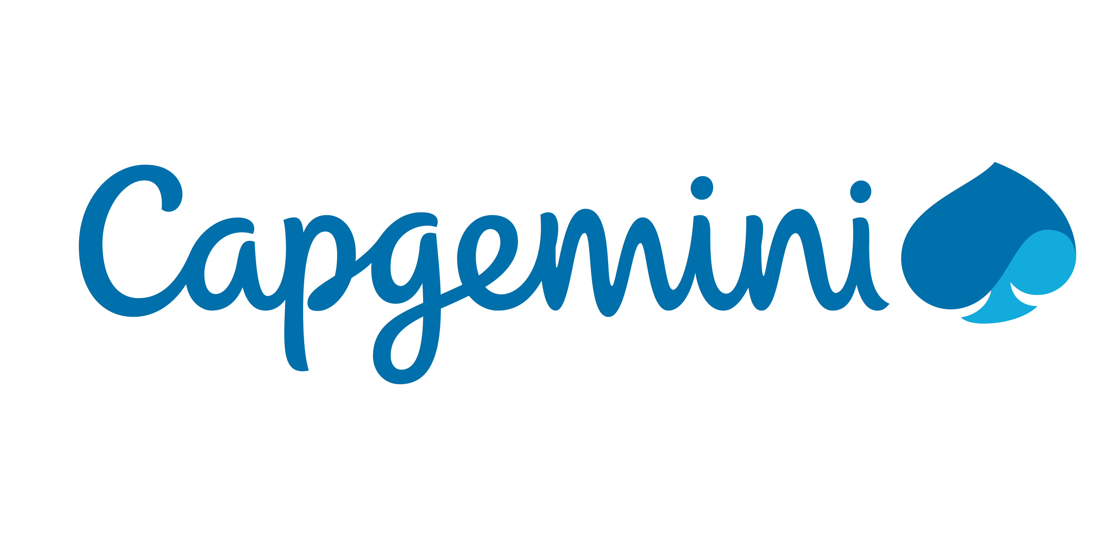

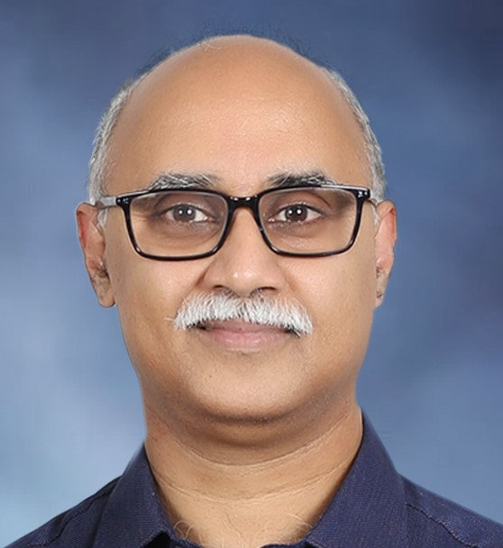
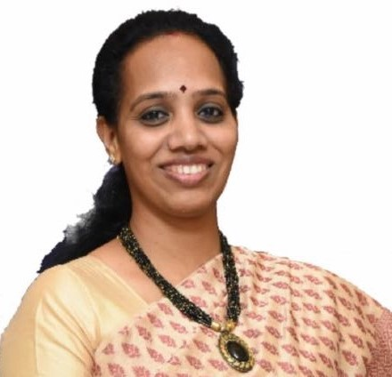
NYL USA Engagement &
L & A CaPAbilities
Unnikrishnan Menon
Senior Director | Delivery Executive for NYL
Aruna Mahesh
Vice President | Global Life Insurance Practice Leader

Slide 3

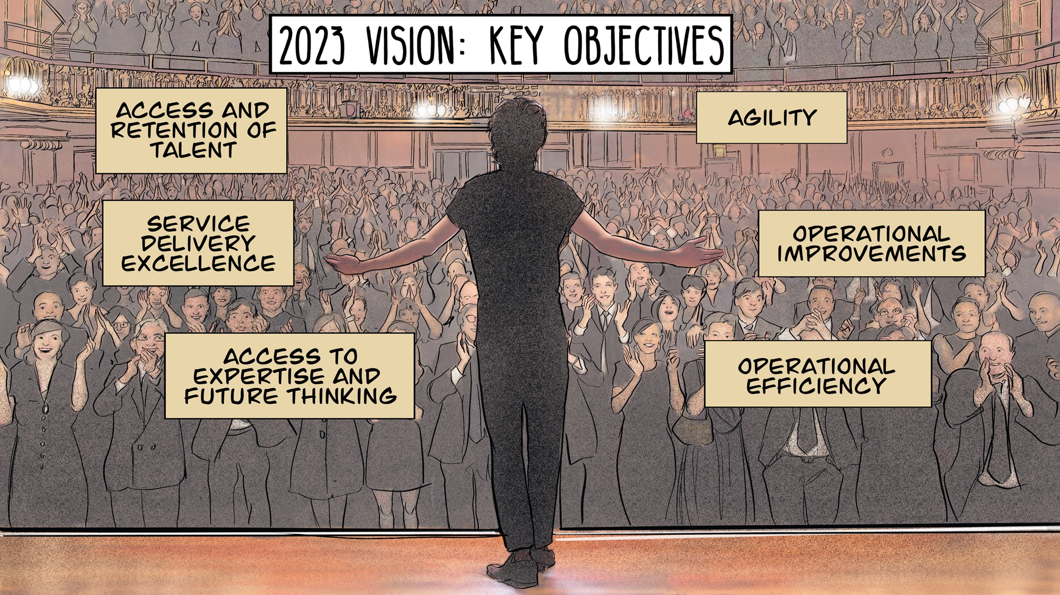
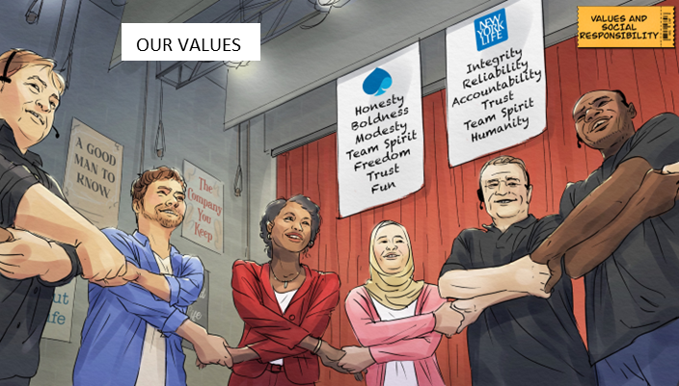
New York Life – Our Relationship
Capgemini US is now part of a 178-year institution, legacy and in NYL’s word's ‘family’
Key Relationships:
Bill Cassidy - Executive Sponsor for Capgemini
Betty Smith - Chief Operating Office, Accountable Executive Officer for sourcing strategy
Bill Mount - Head of Application Support Center for Enablement
Maryann Dias - Head of Enterprise Service Management
Craig Broder - Head of Technology Strategic Partnerships Office
Aaron Ball - Senior VP and Co-Head of the Foundational Business
Daniel Salvatore- CIO Institutional Life
Our Vision:
Be “the” preferred Transformation Partner
Our Values:
Represent a culture that is aligned with NYL
Our Current Footprint:
Run Partner for AMS Managed Services, helping:
  Bring new ideas that challenge internal teams, processes and incumbents
  Address NYL's key objectives through the defined scope of work
Preferred Application Development partner for NYL helping define:
  Transformation solution for Mainframe Modernization,
  Solution for SAP Onboarding and CPI Implementation

Slide 4

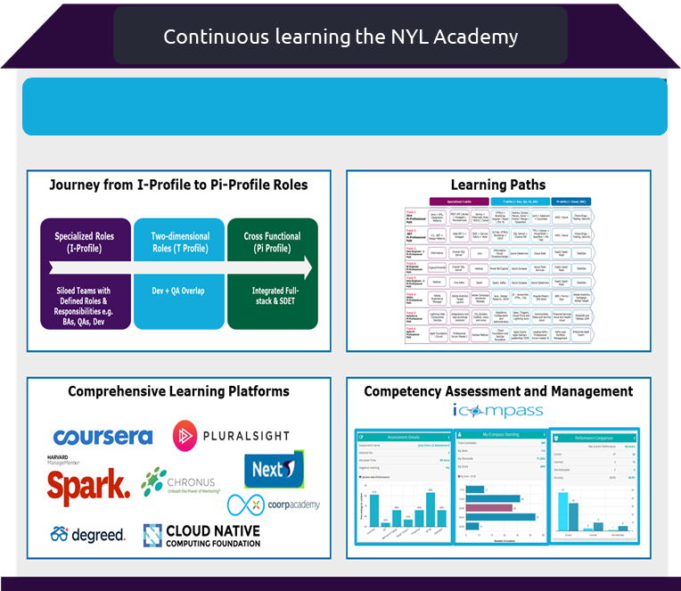
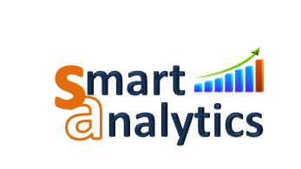
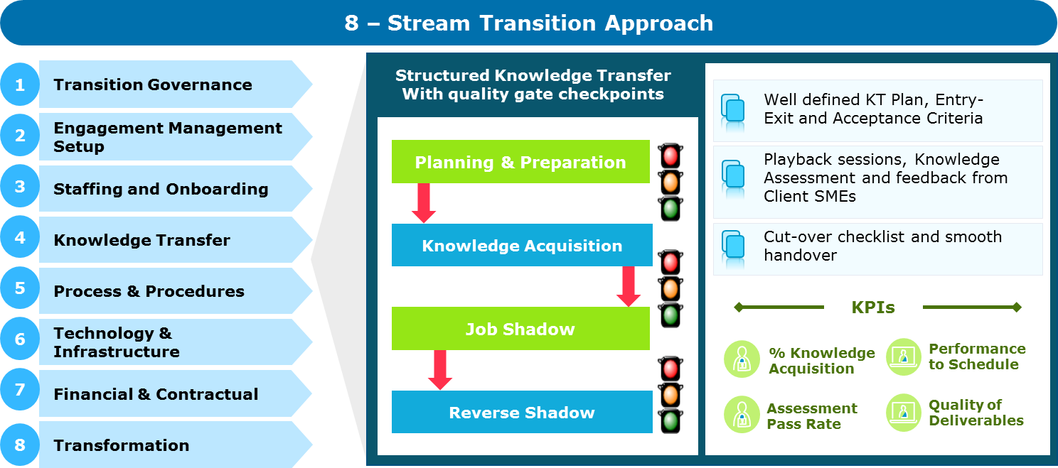
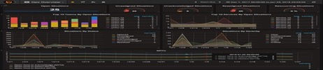

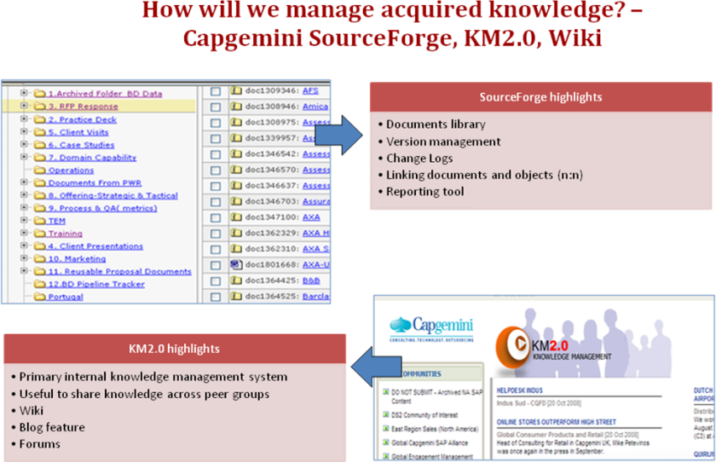
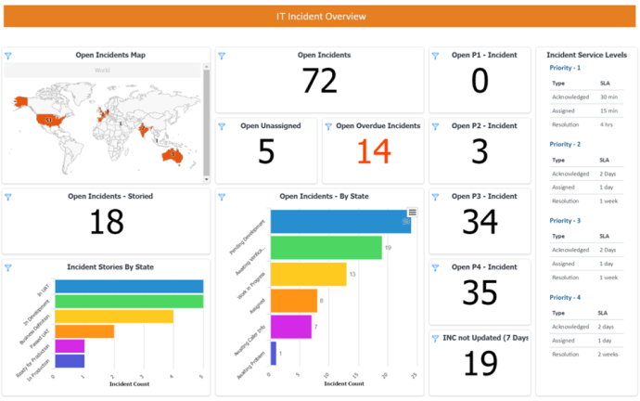


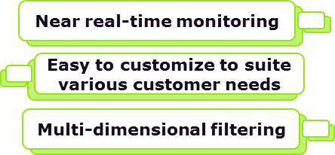
New York Life – OUR Current SCOPE @ US
Dedicated Transition COE
Steady State Transformation
SCOPE HIGHLIGHTS
147 apps involving Large and Complex transitions
~70 associates across Corporate Apps and ITSM
NYL Academy comprising of a competency framework for knowledge ramp up
147 applications across Finance, HR, Communication, Risk, Compliance
32% productivity improvement in 3.5 years
9 processes across 3 workstreams
Corporate Applications Support
Proven Methodology, Tools and Accelerators
Continuous Improvement based on Customer Insights (proactive & predictive)
ITSM
AIOps based Continuous Monitoring solution
Capgemini Intelligent Automation Platform (CIAP) with 3,700+ re-usable workflows (we can also existing tools such as IPSoft)
Onshore – Offshore Model
Proactive Problem Management with SWAT Team, KM Portal and KeDB
US
India
Real Time Performance Dashboard
Through SNOW Performance Analytics

Slide 5


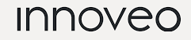



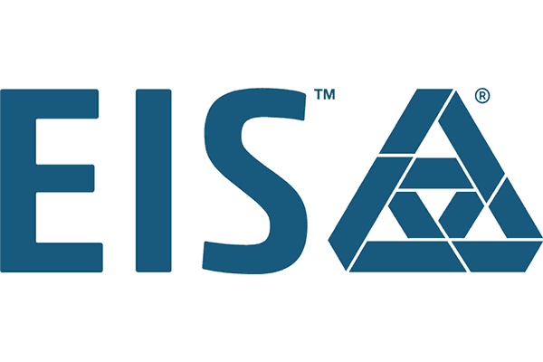



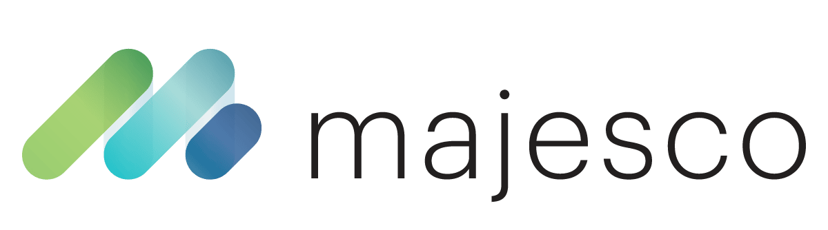











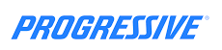




















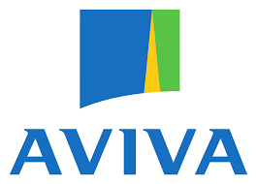







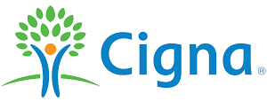





Capgemini insurance at a glance
Quality Engineering & Assurance
Digital
Insights & Data
Business Services
KEY INSURANCE SERVICES
Product & Service Innovation
Digital Business Operations
Application Management
Core Transformation
Digital & Cloud Transformation
Intelligent Automation
Quality Engineering & Assurance
Advanced Data Analytics & AI
GLOBAL BUSINESS CAPABILITIES
Invent
ER&D
Cloud
Global Footprint
Key Partnerships
26,000+ Resources
12/15
Top Global Insurer
clients
P&C | Life & Retirement | Health | Reinsurance
Select Clients

Slide 6

L&A SUCCESS STORIES

Slide 7

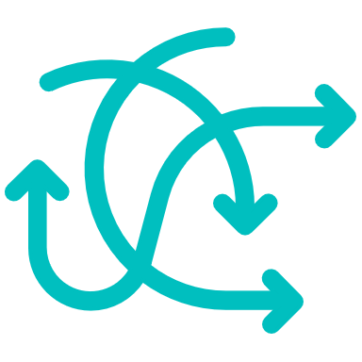

KEY L&A Success CREDENTIALS with global clients
NEW PRODUCT ROLLOUT ACROSS LAH PORTFOLIO
LIFE AND GROUP CLAIMS TRANSFORMATION
BUSINESS PROCESS OPTIMISATION FOR OPERATIONAL EXCELLENCE
IMPLEMENTING A MODERN CORE PLATFORM
Low-Code CoE within 2 months
GTM@Speed and agility
First product rollout in 4 months (2022)
8 week engagement with Capgemini Invent
Future state claimant centric service blueprint
Prioritised & actionable transformation roadmap
Business Process flow driven implementation
Functional & Technical Components re-usability (~70%)
Unified user experience through single workbench
Fully integrated solution with digital engagement
Increased STP and reduced TAT
Rapid adaptation for new, innovative products
  We have helped our clients deliver Innovative hyper-personalized products and services with modern business models and technology using data and analytics

Slide 8

NEW PRODUCT ROLLOUT across LAH portfolio
Business challenge
    Current policy system of the client does not support company vision of digital transformation. They were looking for a partner to accelerate delivery timelines after releasing two personal products in a single province in two years span
    Within a 3-month timeframe leveraging lateral hiring and training, we successfully stood up Innoveo CoE with a 20-member team consisting of Architects, BA’s and Developers spread across India and US.
    Capgemini embedded Innoveo certified resources across different workstreams and positioned the team on end-to-end solutioning to make an immediate impact on the program and released first rollout in 4 months
    We were able to leverage Capgemini’s accelerators on Innoveo, past experiences and resource in delivering large, complex core insurance transformation programs
    Built an Innoveo CoE within 2 months and scaled to team of 20 certified associates with First product rollout in 4 months (Dec'22 release)
    Built accelerators and PoC’s to build trust with customer on this niche skillset.
    Digital Capabilities – The solution provides for paperless billing and electronic delivery of policy documents.
Solution
Impact
Capgemini Confidential
Notes:
Zurich NA – Innoveo LOB: A&H

Slide 9

LIFE AND GROUP CLAIMS TRANSFORMATION
FOR A LEADING GLOBAL INSURER IN AUSTRALIA MARKET
Business challenge
The recent acquisitions resulted in the client having multiple claims teams using multiple platforms (Claim Vantage & OPS) with different guidelines and rules.
Additionally, the client had continuous improvement programs occurring from Data Migration to claims experience uplift. Each program aimed at a specific team and viewed as disjointed from other teams.
Capgemini Invent was brought into shape Transformation Roadmap that will create a coherent and unique future claim experience for the assessor and the customers.
Solution
Over an 8 week engagement Capgemini Invent developed a future state claimant centric service blueprint which informed the future state process design and future state claims platform and resulted in a prioritised and actionable transformation roadmap aligned to three key performance objectives (efficiency, customer satisfaction and productivity)
Outcome
Capgemini has delivered a Transformation Program composed of the following :
3 programs linked to the key performance objectives
  24 discrete work packages
  24 months duration
The client has started the Transformation Program on the 1st of June with the discovery of 4 work packages
Notes:
Zurich Aus Date: Point-of-contact:

Slide 10

INTELLIGENT PROCESS AUTOMATION FOR A GLOBAL INSURER FOR THEIR ASIA OPERATIONS
IMPLEMENT A FUTURE STATE WORKFLOW FOR OPERATIONAL EXCELLENCE
Business challenge
Client needed a one-stop solution that facilitated a. employees risk assessment, policy issuance, claim settlement and address policy servicing requests etc.
In addition a need was felt to launch a separate initiative to strategize a Single Point of Sales (OnePOS) Platform covering Agents, Bancassurance & Direct channel.
Solution
A study of the processes for NB, POS and Claims led to defining a roadmap for the future state workflow solution. The solution encompassed NB (Multi channel app submission, auto data extraction, unified underwriting workbench, automation for application processing) POS (Enhance mobile platform, Automate simple servicing transactions) Claims (Electronic submission, rule based data driven adjudication etc.)
Development and implementation of a workflow solution to cater to the ask and achieve operational excellence and drive operational efficiencies, and enhanced customer service.
Impact
Business Process flow driven implementation
Redefinition U/W rules to facilitate STP
Functional & Technical Components re-usability to the tune of 70-100%
Enhanced efficiency of implementation – client landscape familiarity, implementation experience & expertise
Transformed Existing Workflow system with ‘next gen’ technology stacks
Unified user experience through single workbench
STP, data-driven flow through automation
Notes:
Client: Prudential LLC (Singapore) Date: Dec-2022 Point-of-contact: Gulveen Kaur

Slide 11

IMPLEMENTING A MODERN PLATFORM FOR A LEADING ADING PROVIDER OF SUPPLEMENTAL A&H, DISABILITY, AND LIFE INSURANCE PRODUCTS
Customize Majesco system for enabling quick product development & speed to market
Business challenge
Objective was to expand the benefits horizon as a leading provider of supplemental medical benefits, providing customized solutions for organizations of any size, in almost any industry, across the US.
Radically improve technology footprint and have a fully integrated solution on one platform with digital engagement
Enable rapid adaptation for new, innovative products or benefit plans
Solution
Conducted a blueprinting exercise with the customer to understand the functionality of the products in scope for: product configuration, underwriting, group implementation, enrolment, amendments, endorsements, renewals, billing, distribution management and integration with peripheral systems.
Outcome of the blueprinting exercise was a Gap register to identify what can be implemented using OOTB functionality and customization needed to be the base Majesco system.
Underwriting rules were revised to include new parameters, rating changes for NB and Renewals, tested and incorporated as OOTB functionality.
Functionality and required customization were grouped into 2 phases based on criticality.
The project was executed in FP, Agile mode. Development for Phase-1 was completed in 25 sprints (1 sprint = 2 weeks). Post SIT and UAT, functionality was deployed in production.
Impact
Improved technology footprint to enable rapid adaptation for new, innovative products or benefit plans
Fully integrated solution on one platform with digital engagement
Modernized platform enabling quick product development and speed to market
Increased STP(Straight through processing) and reduced TAT(turn around times)
The solution enables reusability of product across true Group, Voluntary, And Worksite Channels
Future plans include implementation for Group term life, Group Disability, Group UL and Protector products
Notes:
Client: Combined (CHUBB) Date: 2020 Point-of-contact: Aarti Rao

Slide 12

GET THE
FUTURE
YOU WANT
capgemini.com

Slide 13
About Capgemini
Capgemini is a global leader in partnering with companies to transform and manage their business by harnessing the power of technology. The Group is guided everyday by its purpose of unleashing human energy through technology for an inclusive and sustainable future. It is a responsible and diverse organization of over 360,000 team members more than 50 countries. With its strong 55-year heritage and deep industry expertise, Capgemini is trusted by its clients to address the entire breadth of their business needs, from strategy and design to operations, fueled by the fast evolving and innovative world of cloud, data, AI, connectivity, software, digital engineering and platforms. The Group reported in 2022 global revenues of €22 billion.
Get The Future You Want | www.capgemini.com

