Slide 1





THE FUTURE
OF SMNYL
IS TODAY

Slide 2
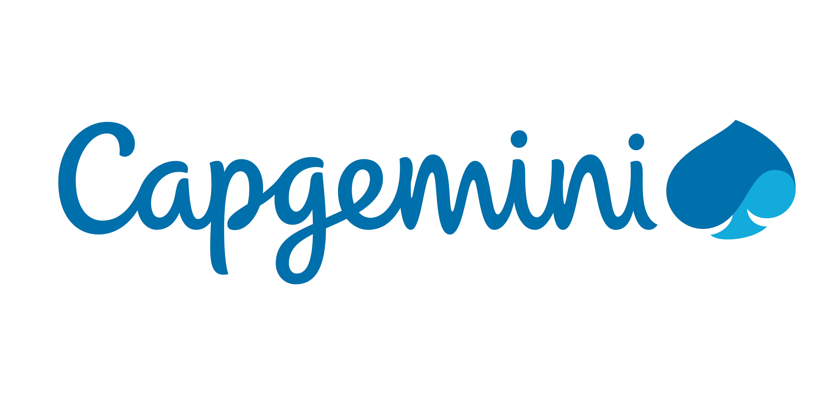

Business Services (BSv)
Insurance services
Javier Cuevas- Business Services Development Director (Mexico City)
Sagarneel Sengupta – Solutions Lead FS BSv (Utrecht, Holland)
Debarshi Biswas – North America FS BSv Head (California, USA)
Doug Petroshius – IPA Client Success Executive (Chicago, USA)

Slide 3
Agenda business services
1
BSv Finance Services – Insurance Services
2
Use Case - BPaaS for a large Dutch Pensionfund
3
Use Case – Experience of launching a new product for a large Insurer
4
Intelligent Automation Capabilities
5
Appendix

Slide 4

BSv financial services – Insurance services

Slide 5
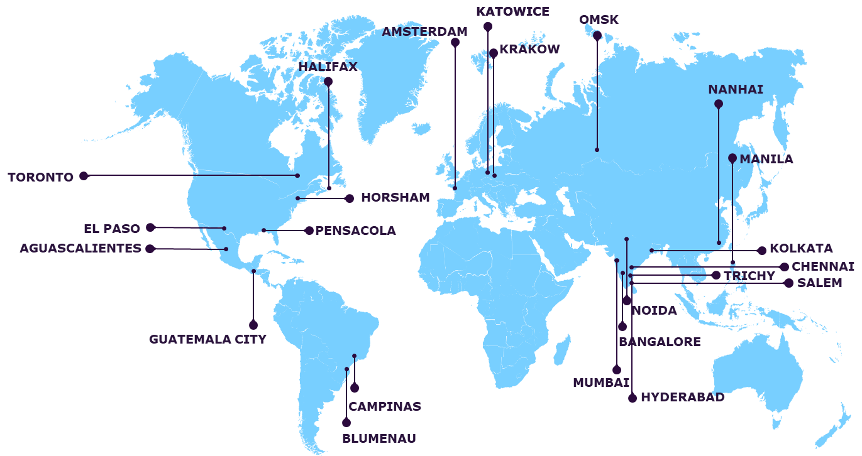

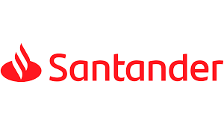













Capgemini business services overview
Laurent/ Sagar
A multi-cultural team of around 27,000 professionals
Delivery Centers
25+ years in business
~40 languages | 24/7/365 global operations
Comprehensive outsourcing, platform and
as-a-service portfolio
130*+ clients in 180+ countries and territories
21 delivery centers
Key clients
Flexible, platform-based methodology for business transformation, automation and benchmarking
Industry know-how and world-class solutions across
all major sectors
INTELLIGENT FINANCE & ACCOUNTING OPERATIONS
INTELLIGENT PEOPLE OPERATIONS
INTELLIGENT CUSTOMER OPERATIONS
INTELLIGENT SUPPLY CHAIN OPERATIONS
INTELLIGENT PROCESS AUTOMATION
Margin improvement
Revenue growth
Working capital increase
Greater controls
Enhanced employee experience
Improved employee engagement
Talent development
Enhanced customer experience
Improved customer engagement
Revenue growth
Reduce cost to serve
Improved customer service
Optimized Capital
Enhanced customer experience
Improved efficiency
Enhanced agility

Slide 6




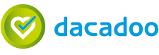
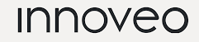

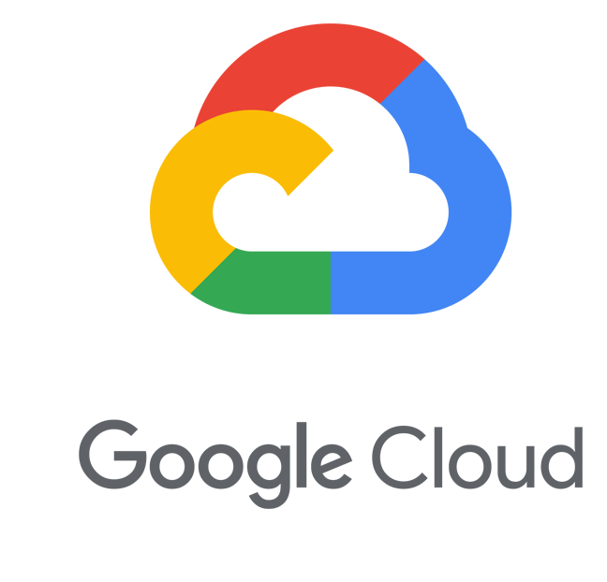

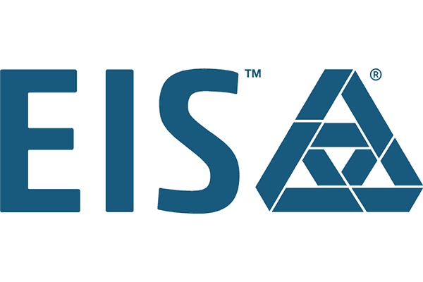



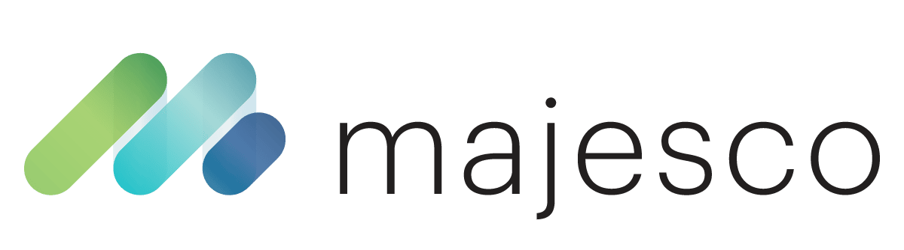

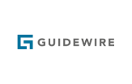









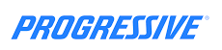


















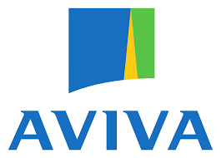



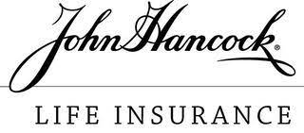
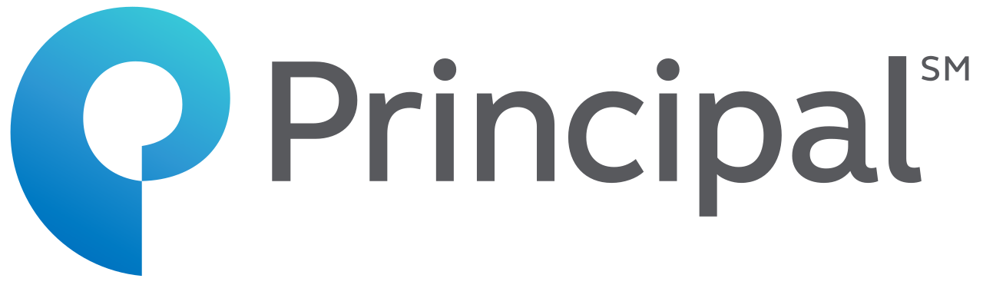
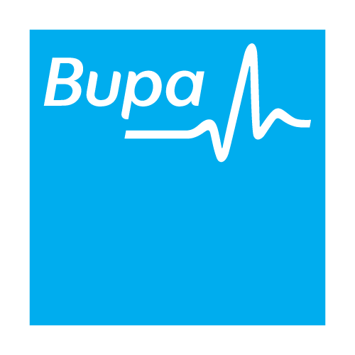


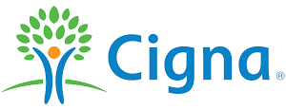



Capgemini insurance at a glance
Digital
Insights & Data
Business Services
KEY INSURANCE SERVICES
Product & Service Innovation
Digital Business Operations
ADMNext
Digital Core
Digital & Cloud Transformation
Intelligent Automation
Quality Engineering & Assurance
Advanced Data Analytics & AI
GLOBAL BUSINESS CAPABILITIES
Invent
ER&D
Cloud
Global Footprint
Key Partnerships
26,000+ Resources
12/15
Top Global Insurer
clients
P&C | Life & Retirement | Health | Reinsurance
Select Clients

Slide 7
Insurance Business Service Capabilities & Services delivered
New Business/ Enrollments
Premium Billing
Policy
Administration
Claims
Administration
Agency
Administration
Accounting & Treasury
Pension Fund
Services
Core
Insurance
(Life, Health)
Application processing
Direct Billing
Demographic
changes
Eligibility
Agent contracting
Account Reconciliation
Manage pension schemes
Underwriting Support
Group Billing
Policy
Changes
Adjudication
Agent licensing
Bank Reconciliation
Employer admin and enforcement
Employment & Participant admin
Risk assessments
Payroll Billing and Recon
Remittances/
Withdrawals/
Loans
Support
Commission processing
General Ledger Management
Entitlement, Payment & Financial admin
Policy Issuance
Suspense Management
Lapse/Renewal processing
PO digitization
Financial Reporting
Entitlement Comms, Front Office & Reporting
HORIZONTAL PROCESSES
    Finance and Accounting
    Record to Analyze | Accounts Payable I Accounts Receivable
    Workforce Management
    Forecasting ⎪ Scheduling
    Employee Operations
    Hire to Retire I Customized Learning Solutions
    Analytics
    Data Collection, Processing and Analysis
    Customer Services
    & Support
    Customer Service | Social Media Support | Technical Help desk
    SECTOR OFFERING
Governance, Risk & Compliance

Slide 8
Use case – bpaas for a leading dutch pensionfund

Slide 9


KEY BENEFITS OFFERED BY CAPGEMINI
Key client needs
Benefits offered by Capgemini
About the client:
One of the oldest and 5th largest in the Netherland, Legally structured as a foundation.
The pension fund is an obligatory fund meaning that every employer in the retailing business in the Netherlands needs to have their pension at BPfD
>20 Billion of Assets Under Management
300K active + 100K retired + 800K inactive policies
Over 40 K retail companies for which CLIENT administrate pensions
Operations and IT were outsourced to a pension service provider
Increased agility
Complete digital transformation of business
DIGITAL PENSIONFUND
Digital channels communication
Significant Cost reduction compared to current spend
End to end ownership of services
End to end SLAs with markedly improved service levels
Global operating model leveraging local and nearshore capabilities
Regulatory compliance

Slide 10

OVERALL CONSTRUCT
Capgemini offers end to end pension administration in a BPaaS model including IT platform build (FS), data migration (I&D), hosting and infrastructure in AWS cloud (CIS) and pension operations (Bsv)
People
Process
  Right skillset at the right location
  Blend of pension and BPO expertise
  Dedicated recruitment engine for pensions ops
  Exhaustive trainings with materials created from the scratch
  Career paths for all employees
  Strong people management practices as a part of service delivery
  Open, collaborative and competitive culture
1
  End to end pension administration covering 180+ processes
  Collaboration with third parties for niche offerings like actuarial and mailroom
  ESOAR approach for process design
  Capgemini service delivery practices ensuring process excellence:
    Compliance framework
    Quality management
    Security controls
    Continuous improvements
2
Technology
4
Organization
  State of the art CRM – Salesforce
  Automated calculation core
  Portals for participants, employers and pensionfund
  Cloud based infrastructure – MS Azure
  Integration with third parties and vendors
  End to end IT support – ADM and helpdesk
  Strong cybersecurity practices
  Dual site delivery to achieve optimized global and local expertise
    Netherlands for front office and knowledge of NL pensions specifics – flagship BSv engagement in NL
    Poland for transactional back-office processes
  Strong three tier governance structure for quick resolution of issues
  Leadership focus and presence in both locations
By combining all 4 of the above areas in 1 operating model, our overall construct ensures highly automated landscape with true digital transformation, with a strong BPO presence to ensure seamless service delivery

Slide 11
Overall Program Target Operating Model.
Collaborative Target Operating Model
Key Highlights and Benefits
Governance
Contract Management
Compliance
Escalation Management
Compliance Office
End to end ownership of service delivery and IT by Capgemini
Business Transformation aided by superior technology platform
Robust frameworks to achieve desired outcomes
Significant cost rationalization
Faster Go To Market and Product launches
Easier on-boarding of other pension funds
Improved customer satisfaction
Delivery Management
Performance Management
Strategic Directions
Change Management Office
Service Delivery
Products
Process
Tools
PMO
Defined Benefits
Employer call center
Employee call center
Employer admin
Value transfer
Batch exceptions
Command Center
Redemption
Persons admin
Death
Divorce
Disability
PROMPT
BCP/ DR
Transversal
Process Compliance
Audits
Operations Management
Continuous Improvement
Legal
Knowledge Management
Reporting
HR
Technology
L1 Helpdesk
L2 Helpdesk
Finance and invoicing
L3 Helpdesk
Application Development and Maintenance
Admin and facility
Hosting and Infra
Interfaces
3rd Parties
Employers and employees
Technical Platform
Technology Partners
Regulators
Client
Quality
Information Security
Business Change Management
New Projects/ RTB
External Advisory

Slide 12
Use case – partnering with a leading insurer for a new product launch

Slide 13



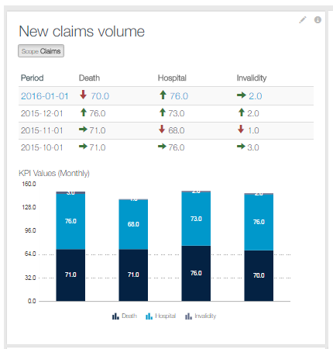
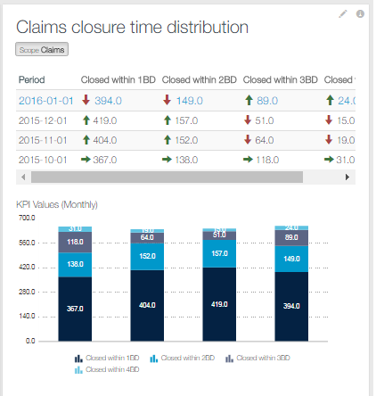


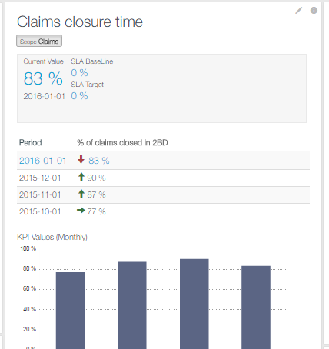
use case : our journey launching a new product
(FAMILY PROTECT) – OUR SOLUTION AND OUTCOME
Capgemini was chosen as the preferred partner to launch a new product and outsource back office operations (policy admin and claims) completely
Geographies: Belgium, France, Spain and Italy
  Contract agreement assuring service excellence
  Transaction based pricing
Sample command center reports
  Defined Service Levels and KPIs measured on a regular basis
Delivery Center: Krakow
  Security of data and business continuity (ISO certifications and regular audits)
FTEs: 30
  Focus on continuous improvement
Languages: French, Flemish/ Dutch, German, Italian, Spanish
    99% of SLAs achieved above the target
  Continuous Improvement and focus on process automation
  Over 150 improvement initiatives implemented to enhance the service performance
  80% time reduction in process reporting due to elimination of manual effort
  Exceptional increase in polices maintained per FTE
    From over 600 per FTE in 2012 till over 5000 per FTE in 2015

Slide 14
Intelligent automation in insurance

Slide 15

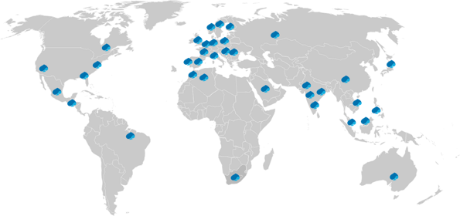








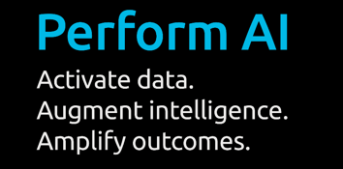


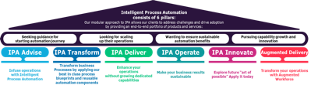













Intelligent Process Automation
Digitally Augmenting Processes at Scale
GLOBAL REACH & CAPABILITIES
15+ Years of experience
10500+ multi-skilled experts for:
Robotic Process Automation,
Artificial Intelligence, ML by
and Process Analytics
3700+ automation use cases and
600+ reusable components in libraries
Proprietary acceleration toolkit
for fast-tracked opportunity discovery and automation delivery
Global follow-the-sun presence for advisory & delivery capabilities
Intelligent Automation Services Leader 2019-2020 by Avasant
EXAMPLES OF IA OUTCOMES WE HAVE DELIVERED TO OUR CLIENTS
10-25% of process scope savings
within 3-6 months
90% reduction in F&A FTE deployment
40% reduction in cost of HR service
20% improvement in demand planner productivity
95% cost reduction in query handling
ENABLING THE DIGITALLY AUGMENTED WORKFORCE
IPA OFFERINGS & PARTNERS
SOME OF OUR GLOBAL IPA CLIENTS
Enabling creation of Frictionless Operations with power of RPA, AI and Analytics
Integrated into Capgemini’s proprietary ESOAR & Digital Global Enterprise Model
Data-driven Digital Twin for Operations supporting accelerated opportunity discovery and process analytics
Rich assets and accelerators
Reuse to scale automation quickly within automation factory
Talent and expertise for Process & Technology transformations joint innovative expertise of Capgemini Business Services, Invent and Insights & Data

Slide 16
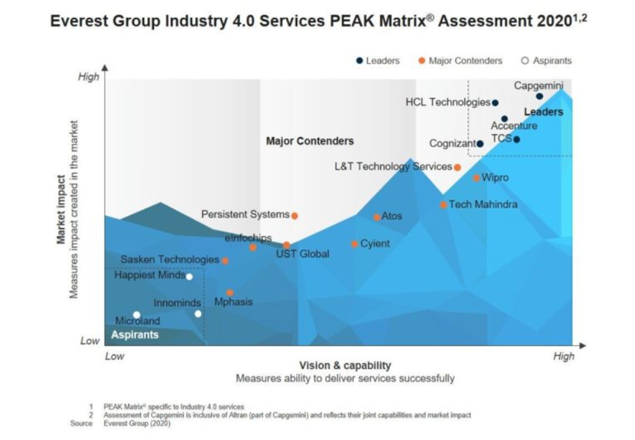
Capgemini focuses on tangible value generated by Innovation
Our approach has been validated & recognized by the market
INDUSTRY 4.0 IS THE LATEST PHASE OF
INDUSTRIAL REVOLUTION
Technology-intensive characterized by the emerging themes of:
Interconnectivity
Digitalization
Automation
SERVICES AWARDED FOR
Consulting and Design
Development and Verification and Validation
Deployment and System Integration
Managed Services and Support

Slide 17
Inteligent Automation success stories
GLOBAL MULTI LINE INSURANCE GROUP
100+ automations
  Ex: Claims, Policy Servicing, Finance Processes
FTE reduction of 30
Efficiency improvement, cost avoidance
LARGE INSURANCE PROVIDER IN NORTH AMERICA
80+ automations
  Ex: Claim Intake Process, Web Policy Endorsement Process, Policy Service and Administration, Claims Reassignment Process, Payment Bot
FTE reduction of 35 (90% transactions processed by bot)
LARGE INSURER IN NORTH AMERICA
    Automations have processed close to 200,000 claims in production
    ROI of 153%
    Less than 5% error rate
    Automation improved end-customer satisfaction through increased turn around time
LARGE REINSURANCE & RISK MANAGEMENT PROVIDER
5 processes
  Report Generation, Claims Onboarding, Policy Back Loading, Reinstatement Authorization, KYC Screening
FTE reduction of 4.5 (~50% benefit)
75% reduced cycle time
Reduced operational cost and improved quality of service
LARGE GLOBAL INSURANCE PROVIDER
61 automations:
  Ex: Finance & Operations, Financial, Reconciliation, Policy Issuance & Renewals, and Claims & Payment
FTE reduction of 40
Automation percentage – 65%
Additional services – IA Center of Excellence
LARGE INSURANCE PROVIDER IN NORTH AMERICA
RPA and intelligent document processing (IDP)
Process: automated intake of unstructured accord forms attached to emails
20% – 23% reduction in annual costs
Standardization of output aligned with the underlying systems resulting in faster turnaround times
Reduction of errors due to manual work (typing, matching, etc.) resulted in up to 30-minute reduction in average handling time

Slide 18
APPENDIX

Slide 19
A Canadian
Insurance Major
    Inconsistent services: Need for an effective solution for enrollment and member services
    Incompetent incumbent vendor: Client was seeking for an outsourcing vendor that could deliver consistently and meet the CTQs
    Inefficient workflow management: Set up a workflow management system to track the member request
    High turnaround time: Need to improve the turnaround time
    Ramp up: Manage volume ramp up in view of the expected rise in the membership
    Broken up processes :
    Implementation – VDR, MDM and IM
    Eligibility – Service, One Service, OA, Additional Service, GH, GF, ASO,
    Non availability of procedure and guidelines for processing
A Canadian Insurance Major (previously, Assurant) is a holding company with headquarters in New York City. Its businesses provide a diverse set of specialty, niche-market insurance products in the property, casualty, life, and health insurance sectors. The company provides specialty protection products and related services to safeguard against risks.
    The Challenge
x
    Restructuring proposed for one fragmented LOB and 3 separate LOBs joined together to create a single LOB
    In absence of SLA reports implemented controls, inhouse tracking tools created to manage SLAs
    Structured approach by creating tools to manage production & accuracy for daily & monthly basis
    Developed capabilities to enhance skillset of existing resources
    Implemented production tacker to capture daily & monthly production
    TAT tracker created & implemented for multiple functions
    SOP restructure to enhance the product knowledge
    Multiple letter tool automation to improve end customer satisfaction
    Automated inventory assignment tool implemented
    SOP Restructuring initiated
    Sub process of a process aligned in single process
FS
    The Solution
    Scope: New business enrollments, Policy Administration, Broker Services, Life & Disability claims, Dental claims, etc.
    Delivery Centers: India (Noida, Trichy and Pune) and USA (El Paso) Languages: English Methodologies/Tools: Rightshore® and VMware
    Starting with an average volume of 1300 a day, ramped up to handling about 6000 lives during peak and 500 during non peak
    Improved the turnaround time by 30% for member services
    Successfully completed transition of enrollment, member services, policy termination, medical underwriting, indexing, and presales process
    Enabled the client to analyze the volume and type of member requests received
    Ensured the transaction volume for new business/ enrollments as 500k annually
    Through LOB restructure approach TAT improved from 6 days to 72 Hrs
    No dependency on business for SLA management
    Automated Production details
    SOP restructuring for accuracy improvement
    Enhanced end customer satisfaction through letter tool implementation
The Outcome

Slide 20
A Canadian Insurance Major
Our client offers a wide variety of products in Life and Finance. Leading provider of providing Insurance, Investment, Financial Advise and Asset Management. has a presence in investment management with over CAD$891 billion in assets under management operating in a number of countries. Ranks number 277 on the Fortune 500 list. Sun Life also offers voluntary (employee-paid) disability, life and dental plans.
Client Overview
The Challenge
The Solution
The Outcome
    Multiple fragmented processes in small pieces
    Process documentation
    Enhanced Training & Quality design as per changes and updates
    Reporting mechanism
    Standardization of process
    Better visibility into the process metrics and Key Performance Indicators
    Process restructuring was completed for all major line of businesses and initiated end to end processing for improved service level agreements
    Revamped Training and Quality model and created a structured model for Training and Quality monitoring & implementation
    Global Process Model (Governance)- Command Center introduced for improved governance and started furbishing reports through Command Center portal
    Technology involved for removing manual dependency for reporting purpose. With the help of Command Center reports were automated
    Process workflow designed and process maps were developed for standardization
    Strong collaboration developed with SLF
    Improved and consistent performance results
    Structured line of businesses
    Process restructuring helped in resource crosspollination
    Resulted in adding 2 new LOB’s in last one year with total TCV of M€ 1.44
    Got an opportunity to be a part of UAT with SLF for any system release /update. 1 additional FTE involved in UAT work
    Improved SLA & reporting charter in place for better KPI and performance visibility
Processing
Indexing
Delete Coverage
AE New Issue
ASO
AE Add Coverage
Categorizing Presales Documents
Premium Accounting
Categorizing post sales document
Medical Underwriting
Life & disability claims
and Mailroom
Provider & Member Match
Online Advantage transaction
Write out & missing transaction
Member level Amendment
Administrative Amendment
Review for Medical Underwriting
Member Install & Request first bill
Additional Admin Service trans
Voluntary Deduction Report (VDR)
Life Conversion
Re-enrollments
Member Data
Transfer (MDT)
Add Coverage
Re Enrollment
Conversion
Sales Force
Broker Services
Maxwell Health
Conversion Policy Setup
EDX
Transition Mailbox
    2010
    2012
    2013
    2015
    2016
    2017
    2018-19
    2010
    2011
    2014

Slide 21

Global Process Automation Program for a
Large Insurance Company Present across the Globe
This global multiline insurance group is active in 170 countries (NA, EMEA, UK, APAC, LATAM) and provides life and general insurance to individuals as well as corporations. After a successful proof of concept, the committee chaired by the Group COO selected Capgemini as their strategic partner for Robotic Process Automation.
Overview
Business Scenarios
Capgemini’s Approach
Benefits
Business Process Overview
The Group announced an ambitious global cost reduction target and started a transformation program that included investments in new technologies to achieve efficiency gains.
An initial process review identified 200 potential processes that were candidates for automation spread across the globe.
Process areas in which efficiencies were sought in the first year include:
    Finance and Operations
    Financial Reconciliation
    Policy Issuance
    Policy renewals
    Claims handling
    Claims payments
Semantic in Claims Automation on different types like policy documents, doctor prescriptions, diagnosis report, physiotherapy reports, and so on
    Setting up a distributed IPA Center of Excellence with a central team, regional teams, and an offshore IPA Delivery Center
    Full IPA life cycle approach starting from opportunity identification, through automation, maintenance, and operation to continuous improvement
    Local process scans identifying opportunities for Lean Improvement, Robotic Automation, and Cognitive Automation
    International rollout of robots for similar processes leveraging re-usable components
    Combination of IPA and Cognitive Automation to automate end-to-end processes with complex decision making
    Setting up an IPA Center of Excellence with a central team, regional teams
    Semantic analysis analyzing the documents and finding the relevant information from the documents
    IPA inputs the documents to Semantic analysis and receives the results. Decisions made based on semantic results to complete the process
    Savings of $ 5.5 million YoY in terms of FTE saving, efficiency improvement, and cost avoidance
    Policy renewal time reduced to 45 mins (~70% improvement)
    Automated 65% of Manual tasks resulting 60% FTE reduction
    Successfully deployed 120+ bots automating 64 processes across Global processes
    Improved customer experience
    Improved control from risk and governance perspective and reduction in risk related to fraudulent business
    Semantic solution helped reduction of load on handlers by analysis of text from the documents to identify the required information
    Semantic solution helped save 20 FTEs out of 27
    FTEs (savings of 40000 hours per year)
Notes:
Doug added because it’s policy-related

Slide 22
Policy Renewal Process Automation for Major P&C & Commercial Insurer in Japan
The client is one of the largest P&C Insurer in the world based out of Japan. The requirement was to improve the efficiency and effectiveness of the following processes using IPA:
Creation of new insurance contract
Renewal of existing insurance contract and refund of closed insurance contact
Overview
Business Scenarios
Capgemini’s Approach
Potential Benefits
    Business Process Overview
    The team needed to manually handle data in Excel sheets containing as many as 17000+ records
    Manually feed bulk data to core Insurance Application ASOQ (Web Based) received from various agencies
    Manually read information from CSV and write them in the Excel template
    Reading information from Excel and update Mainframe (IBM)
    Interfacing three unique sources, that is, Legacy mainframe application, Core Insurance application, and other standalone system/files
    Fetching “Bank Code” for each customer from a collection of bulk data placed in a .Dat file
    Analyzed, design, and implemented automation for the processes using WorkFusion
    Robot designed to refine and validate data before putting it in the application
    Automation of business processes eliminating the need of manual data entry
    Robot developed to highlight exceptions and notify concerned authorities
    Four robots are deployed in production environment
  The client was able to realize the following benefits by implementing IPA:
  ASOQ process saw FTE reduction of 22.9% and the mainframe process had the reduction of 74.2%
  Reduction of errors due to manual work (typing, matching, etc.) resulted in a very efficient process
  Increased customer satisfaction
Notes:
Doug added because it’s policy-related

Slide 23
Renewal Letters Process Automation for a
Leading Insurance Company in Canada
The client is a leading Insurance Company in Canada. Reports are generated from Application Report Explorer 2 months in advance with the renewal letters sent for each policy. Numerous process steps are involved.
73%
Reduction in average
Handling time
(15 to 4 mins)
99.3%
Process quality maintained
for 3+ years
Underwriting Data
Validation
Bot creates and sends renewal letters
for Core Life Term 10- and
5-Year Renewable Life Insurance
and updates workflow management
system
Workforce Augmentation
Humans & Automation
    Instead of reducing FTEs, the automation augmented human workers by leveraging attended bots, as well as unattended bots
Image Recognition
Process performed in Citrix; thus, a powerful image recognition engine was leveraged that would not be possible with RPA alone
Notes:
Doug added because it’s policy-related

Slide 24
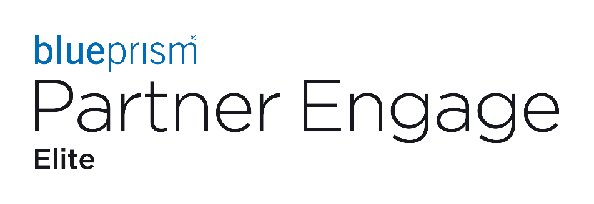
Claim Center Automation for a Large P&C
Insurance Company based in the United States
The client was a large P&C insurance company based in the United States having multiple lines of business. The client wanted to implement IPA to automate their Claim Center operation to save on FTEs and drive overall operational excellence.
Overview
Business Scenarios
Capgemini’s Approach
Benefits
Business Process Overview
The customer was looking to leverage Intelligent Process Automation (IPA) to reduce the number of human claim processors required to process Auto and Property claims. Claim payment processes are similar between lines of business but not exactly the same.
The high-level claim processing steps are:
    Receives 270,000 claim via phone call, email, Website, fax, or mail annually.
    A first notice of loss (FNOL) department initiates the claim in claim center and assigns the claim to the appropriate claim processor.
    The claim processor contact (if necessary) the claimant or policy holder to gather more information.
    The claim processor researches the claim to determine if a payment is appropriate and the amount of the payment.
    The claim can be re-assigned based on research.
    The claim can be paid and closed based on the research.
    Capgemini spent 6 weeks identifying and prioritizing IPA opportunities with the P&C claims processing area.
    Identified 42 IPA opportunities:
    Each opportunities save between 2 and 12 FTEs
    Selected 8 processes, or sets of tasks, for the first round of automation:
    8 selected automation saves a total of 35 FTEs
    A schedule was created to deliver the 8 bots using a factory model in 24 weeks:
    Created an IPA delivery team with 3 Onshore and 8 Offshore resources
    Capgemini also met with the IT team to plan the infrastructure requirements for IPA solution.
    Capgemini assisted the client to set up an IPA CoE, support structure, and ongoing IPA identification process
The 8 IPA bots were built and delivered to production with immediate results.
Four bots were delivered by May 2019.
The bots are processing about 90% of the transactions received, routing the remaining 10% to humans for manual intervention.
Elimination of the manual activities saved the client over $1.8 M annually and eliminated up to 2 days in the claim processing turnaround.
Four under-development Claim Processing Bots have been scheduled for delivering saving an $0.75 M annually.
Four additional Claim Processing Bots have been scheduled for build saving an additional $0.75 M annually.
The client is expanding IPA into other portions of their business including: Health and Life, Policy Management, and Finance.
Notes:
Doug added because it’s policy-related

Slide 25

Semantic Analysis with
Robotics Process Automation for a large
Swiss Insurance Company
The General insurance injury claims at insurance are processed by the claim handlers. This process has lot of interaction with external systems. Also, a lot of analysis of documents and decision making is involved in processing. The documents attached to claim are of different types like policy documents, doctor prescriptions, diagnosis report, physiotherapy reports, and so on. These documents need to be checked and a conclusion on claim need to be made. Also, tight SLAs for processing exist. The complexity led to human errors and more time for processing.
Overview
Business Scenarios
Capgemini’s Approach
Potential Benefits
    Business Process Overview
    The process had a lot of interaction with external systems and involves a lot of analysis of documents and decision making. Multiple types of documents (policy document, doctor’s prescription, diagnosis report) are attached to the claims. All the documents are to be checked and a conclusion on claims need to be reached. The following outputs were expected from the automation:
    Automate the claim processing to improve speed of processing
    Avoid SLA slippage
    Avoid human errors
    Reduce burden on the claim handlers
    The solution with a combination of Semantic analysis and IPA
    Semantic analysis helps analyze the documents and finding the relevant information from the documents
    IPA input the documents to Semantic analysis and receives the results. Decisions made based on semantic results to complete the process
20 FTE savings out of 27 FTEs (savings of 40000 hours per year)
Reduction in process handling time to 5 min
Reduction of load on handlers by analysis of text from the documents to identify the required information
Reduced human errors
SLA slippage was checked
Notes:
Doug added because it’s policy-related

Slide 26
US Insurance Leader
    Enrollment Management:
    Inconsistent volumes: Inability to forecast volumetric trends resulting in subsequent backlogs
    Enrollment solution: Need for an easily customizable enrollment solution
    Platform required to perform all prechecks to send an accurate membership app to the Center for Medicare Services (CMS)
    Penalties: High penalties due to delay in payment and customer complaints
    Complicated electronic load process & Immediate ramp-up required from 40 to 150+ FTEs
    Integration: Need to integrate two applications for eligibility and enrollment processes for various Medicare products into one
    Datacap: Multiple request received from Members in this queue and need to categories the request and route to correct queue.
    The guide has several sample screenshots of queue details so unable to identify the correct request by searching.
    Request are being routed incorrectly as a result of lower the quality and increasing the rework
    customer escalation, Imposition of Penalties and High turnaround times (TAT) cause backlogs
    Transaction Reply Report (TRR): Receive multiple TRC (Transaction Reply Codes) unique codes request which are created by CMS.
    Every TRC unique codes has a unique description and processing guideline
    In each case users must type notes manually which is a time-consuming task and there are chances of errors.
With more than three decades of experience operating government-sponsored programs, it is the largest Medicaid Managed Care Organization in the country, the largest carrier on the Health Insurance Marketplace, and a national leader in managing long-term services and support.
    The Challenge
x
    Enrollment Operations:
    Provided data entry and data validation services
    Implemented Integrated Technology and Operations model for Medicare enrollments processing via a single platform
    Developed an Auto Batch report generation system
    Methodology/Tools: Citrix, Xcelys, IBPS, Market Prominence, FileNet, and SharePoint
    Datacap: All example screenshots were analysed and categorised based on the major request types
    CG developed a macro tool to identify the relevant doc type by filtering out those request types.
    Users can use this macro tool to filter the precise screenshots and send the cases to the appropriate queue.
    Additionally introduced a number of possibilities extra filters to acquire precise sample screenshots of each request type
    Transaction Reply Report (TRR): CG has created a TRR Comment assist tool for standardised the comments available for new & old users to reduce common notes errors.
    Before the implementation of the TRR comment assist tool, users were manually typing notes
    After the tool's implementation, users' efficiency increased by 14.5% and the likelihood of errors decrease
FS
    The Solution
    Scope: I2R Claims Management, data entry and validation, reporting, enrollment services
    Delivery Centers: India (Noida and Trichy) and US (El Paso)
    Languages: English Methodologies/Tools: Citrix, Xcelys, Market Prominence, FileNet, NetSuite, and SharePoint
    Service Go-live: 2002 (ongoing)
    Achieved huge cost savings — $200K
    End-to-end business handling
    Elimination of paper — 100% automated processes for document retrieval, repository, and processing of inventory
    Utilized Capgemini’s in-house trainees from cross LOB to manage sudden volume spikes
    Standardization of procedures — Centralized MIS for reporting and audit purposes
    Improved Accuracy from 90% to 97%.
    Penalties are reduced and cost are increased in revenue.
    TRR Comment assist tool – To process one member’s account users were taking 5mins earlier, now with help of automated TRR comment assist tool the entire activity takes 4 mins. On an average the team used to perform 100 accounts per day in non-AEP (non-peak season) and in AEP (Peak season) 1000, Thus helped us saving 2 FTEs work by reducing manual comment typing intervention.
The Outcome

Slide 27
Leading Health Coverage Provider
    Costs: Request to reduce costs as all claims were being processed by the US-based employees
    TAT: Need to reduce the average time taken to process a claim (30 days)
    Inconsistent volumes: Inability to forecast volumetric trends, resulting in subsequent backlogs
    Reporting: Need to reduce manual reporting
    Insights: Inefficient business insights prevailed
    Accessing application outside Citrix is a bottleneck for automation opportunity
    The process involves high level of manual intervention and various logics to be applied that lead's chance of manual errors
This Company is, located the United States and is part of the Insurance Carriers industry. It has total 250 employees across all of its locations.
The Challenges
x
    Offered claims management/delivery through Noida delivery center to enable cost saving
    Leveraged Capgemini’s existing insurance knowledge to understand the process and develop training documents
    Introduced volume-based delivery commitment to make sure no backlogs are created
    Formed an audit team within Capgemini and initiated quality enhancement programs
    Called providers from offshore directly to cut down the claims TAT
    Forecasted volume trends and plans for at least 110% of the committed volumes accurately
    Approached the customer after looking at all the possible scenarios
    CG team has done ESOAR study to reduce the manual effort in the end-to-end claim processing
    The Solution
FS
    Scope: I2R (Claims Management)
    Delivery Centers: India (Noida)
    Languages: English
    Methodologies/Tools: Work Distribution tool and Randomizer Audit tool
    Achieved flexibility on legal requirements and cost savings
    Realized 20% productivity saving that was passed to customer
    Eliminated client’s fixed costs
    Achieved an accuracy level of more than 99.6%
    Captured all the outcomes
    Received 5/5 OTACE score for 2021
    To reduce claims process inefficiency
    The Outcome

Slide 28
    Pet Insurance Company
    High TAT of ageing policies, resulted in a huge backlog
    Sudden volume spike and massive backlog in Adhoc Projects
    Lack of documentation & guideline
    Security risk of using Google drive and open internet. Secure work from home environment
Pet Insurance company is a New York City based company, providing insurance for Pet owners to cover vetenary bills. The company offers fully customizable insurance plans for pets. Petplan health insurance is known for providing comprehensive coverage for care, including dental coverage for oral diseases and injuries. Its insurance policies are administered by insurance Services, underwritten by AXA XL Specialty Insurance and AXIS Insurance Company.
The Challenges
x
    Introduced volume-based delivery, worked on aged policies to manage ageing TAT
    Controlled spike volume by putting extra hours and improved turnaround time and cleared all the backlog
    Used a collaboration model that encourages peer to peer coaching
    Brainstorming workshops, standardization inputs discussions jointly with onshore team
    SOPs were established based on the feedback and experience on the projects to fill knowledge gaps
    Identified mitigation strategy for security risk of using Google Drive and open internet. Created segregated V-LAN to access G-Drive from CG & VPN for work from home
    The Solution
FS
    Scope: 2nd Underwriter, Adhoc Projects, Billing Proficiency
    Delivery Centers: India (Noida)
    Languages: English
    Methodologies/Tools: Sapience, Stripe, E360, AWS, Marketing Cloud, Crashlytics, Lis Track, JIRA, Confluence and Google Drive
    Completed all aged policies work before TAT
    Backlog in Adhoc Projects cleared within required time frame
    Consistently delivery on productivity goals – achieved 100%, eliminate backlog
    Seamless delivery with an improved efficiency experience
    The Outcome

Slide 29
US Health and Life Insurance Leader
    Insurance booklets follow different processes with the same publishing tool
    Manually intensive processes, limited reuse of content, Frequent update to the input document (Paperwork)
    Sub-optimal workflow tracking, lack of visibility on deliverable status
    High cost of insurance booklet production
    Non-uniform workload
    Impacted speed to market
    QuickSilver tool used for booklet creation is not user-friendly
    Change in instructions throughout the year for creating booklets
    Difficult to implement automation due to complexity
    Quality issues in SBC (Summary of Benefit Coverage) process which leads to not meeting the target of 85%
    Meeting 1/31 goal to deliver all the 1/1 effective booklets to Sales Team
    SOP and Checklists provided by the clients are outdated
    To increase the quality and decrease the process time
US Health and Life Insurance Leader is the largest health insurer in the United States and the fourth largest overall.
The company offers a wide variety of health and life insurance products and related services. It is dedicated to expanding access to high-quality, cost-effective healthcare and equipping members with information and tools so they can make the best healthcare decisions for themselves and their families.
    The Challenge
x
    Building a shared service center between Chennai and Noida, India
    Introduced a workflow management tool, Total Process Manager (TPM), for effective management
    More transparency and knowledge sharing by putting all data on a single platform (SharePoint) for all the process
    Effective and efficient training process: New Insurance Booklet Content Management Specialists are trained within 8 weeks
    Improvement of accuracy through robust Quality Management System (QMS)
    Leverage advanced publishing platforms like HP Exstream and Arbortext Editor through process and tool transformation study
    Renewal booklets are converted to RTF format
    Client is working to eliminate QuickSilver and introduce a new platform (P2A) for booklet creation
    Simple Macros and MS Office based enhancements are leveraged to expedite booklet creation
    Introduced multiple levels of audit in SBC (Summary of Benefit Coverage) process
    Increased the team size to handle the peak season to meet TAT in SBC (Summary of Benefit Coverage) process
    Capgemini team to assist client to deliver the booklets to Sales Team
    Discussed and updated all SOPs and checklists with Clients
    Reviewed the entire process and identified process improvements through Six Sigma methodology
    The Solution
FS
    Scope: ECM and Insure to Recover
    Delivery Centers: India (Chennai and Noida) Languages: English Methodologies/Tools: Global Process Model© (GPM) and Rightshore®, QuickSilver, GEMS, Salesforce, BlueStar, P2A, UCR and TPM
    Estimated 30‒40% productivity benefit with both TPM implementation and Platform transformation
    Reduced TAT under 90 days for all insurance booklets irrespective of fluctuation in volumes
    Lowered administration costs by 40%
    Process optimization through TPM and document organization
    Realignment of client operations to focus on core business
    30% speed-to-market improvement
    Improved TAT from 212 days to 43 days against a target of 60 days within 4 months
    Improved quality from 40% to 88% in 5 months
    Process accuracy has improved because of working in RTF files
    Production time has decreased by 10% due to working in RTF files
    For the year 2023, booklet quality is at 98% against the target of 85%
    For the year 2023, SBC (Summary of Benefit Coverage) quality is at 99% against the target of 85%
    SBC TAT has continuously improved; TAT is tracking at 2.4 days against the target of 5.5 days
The Outcome

Slide 30
Prudential Financial
Prudential Financial is a leading provider of Insurance and Financial Services and ranks amongst the Fortune 500 companies. Service lines include life insurance, annuities, retirement-related services, mutual funds and investment management. 2nd Largest Life Insurer in the US (Life and Group combined), it has presence in Japan, Taiwan, Italy, South Korea, Brazil, Argentina, Mexico, India and China.
Client Overview
The Challenge
The Solution
The Outcome
    To revamp Prudential’s existing web-based trainings to make them visually rich and highly engaging. and to support their eLearning team in keeping the materials up-to-date.
    To support the Prudential Instructional design team in handling regular updates to the material and beautifying them with appropriate graphics from the library .
    To support the Prudential Knowledge Management (KM) team to be able to meet the five-business day SLA in handling Revisions requests for updating eBooks on Pru library hosted on SharePoint Online platform.
    To be able to convert the process flows to GPS (Guided Procedure & Support) to meet the project timelines.
    Capgemini developed various templates and innovative ideas for making the web-based training engaging and effective .
    Capgemini also created a repository of reusable assets and checklist and guidelines to bring about an efficient output.
    Capgemini underwent required knowledge transition for handling KM revisions and successfully took over more than 65%+ of their requests, effectively utilizing the time zone difference. We also trained new /existing Capgemini resource in various KM processes as and when required.
    Creative and highly engaging courses help Prudential retain their learner base and ensure that the training becomes more effective and less of a page-turner.
    Visually rich PPT material with updated information helped engage the class participants more effectively.
    Continued KM support helped reduce the bottleneck of Revision requests and achieving the five business-day deadline.
    Created opportunities for more SOP and Process Flow.
Offering: Content Devt. & Support, Knowledge Management & SOP Creation Support
Technology Stack: Articulate 360, Adobe Creative Suite, Vyond, MS-Office tools

Slide 31
US Based Insurance & RETIREMENT SERVICE PROVIDER
Transformation Led Finance Operations + AI Augmented Workforce
Leading United States-based mutual life insurance firm that provides life insurance, retirement planning, annuities, income management, long term care insurance, disability income insurance, and other products and services for individuals, business owners, and corporate and institutional markets.
Challenges | Solution | Results
Across Finance & Accounting processes, the firm faced: High cost of operations, Fragmented processes and governance, Delays in delivering financial insights A high portion of people’s time mobilized on transactional activities, without enough opportunities to develop analysis and insights Challenges in attrition, and knowledge gaps The roadmap and vision for the future of the finance organization was not established Along the years, the firm first had to maintain operations onshore, then realize efficiencies with offshoring, while addressing operations challenges due to the pandemic | For Finance & Accounting, Capgemini developed: A business-case based target operating model, Standard processes with Capgemini assets D-GEM and ESOAR leading practices An end-to-end digital transformation, including with the leverage of SAP, Cadency, Q2R, Refinitiv, Command Center, SharePoint, 10 RPA projects, and a competency mix review Five years business services relation, with transactional activities of Record-to-Analyze operations: Initially transitioned onshore (2017) then offshore (2020) for ~120 FTEs For a processes scope expanding from core controllership and treasury now including broader finance, Tax, and FP&A With a Global Command Center providing live transactional performance and results | Standardized F&A processes, with continuous improvement governance established Guaranteed operational productivity Estimated automation of over 90% of transactional activities Reduced outstanding open items > 90 days. A Global Command Center enabling a drill down to transaction level details with: 30% reduction in delivery timelines of exception reports Proactive controls monitoring 90% automated data
Business Case
Target Operating Model
Digital Transformation
Transition
Finance & Accounting Operations
with Monitoring & Continuous Improvement
Notes:
Update title
If kept, need to make it client agnostic (not FSH)

Slide 32

GET THE
FUTURE
YOU WANT
capgemini.com

Slide 33
About Capgemini
Capgemini is a global leader in partnering with companies to transform and manage their business by harnessing the power of technology. The Group is guided everyday by its purpose of unleashing human energy through technology for an inclusive and sustainable future. It is a responsible and diverse organization of over 360,000 team members more than 50 countries. With its strong 55-year heritage and deep industry expertise, Capgemini is trusted by its clients to address the entire breadth of their business needs, from strategy and design to operations, fueled by the fast evolving and innovative world of cloud, data, AI, connectivity, software, digital engineering and platforms. The Group reported in 2022 global revenues of €22 billion.
Get The Future You Want | www.capgemini.com

